Slide 1

Employment Trends: Desirable Applicant Skills of Physics Degree Holders
Sylphrena Kleinsasser, APS Careers Intern

Slide 2

Presentation Overview
Goals
Results
01
03
Approach
Conclusions
02
04
Project Motivation and Goals
Data Visualizations and Results
Technical Approach and Reasoning
Final Thoughts and Conclusions

Slide 3
Internship Goals
Perform a quantitative analysis of the types of skills that are common to job descriptions.
Create and catalogue a database of job postings on the APS Job Board.
Examine correlations between skills and factors such as employment sector, job permanence, and degree requirements.
Notes:
Talk about motivations here

Slide 4

Project
Approach
Existing Tools Could Analyze Our Data
A Custom Solution is Better
Excel Classification Preprocessing & Improvements
Notes:
Various tools exist to catalog and analyze data. However, we needed a program to identify and count important keywords in our data, based on specific conditions we specify. This is possible in tools such as excel, but such solutions are slow and difficult to implement. Rather, we chose to build our own program to achieve our goals.
Some classifications, such as job permanence, are not given by the job board. This means that we need to make those classifications as a prior step in order to analyze our data based on those conditions. We used excel formulas to achieve this. In the future, we could build that pre-processing into our custom solution

Slide 5
Technical Choices
Python
SQLite3
Pandas
Simple, high level programming language to act as a base for the program and interface with the user
Fast, locally stored database system that stores and queries job data
Efficient data processing module to import and export job data from the SQLite3 database.

Slide 6
How it works:
PySimpleGUI interfaces with the user and sends user selections to Python
Python counts the most common words in job postings to use as keywords in a filter based search
Pandas parses data for import or export from csv spreadsheets
SQLite3 takes keywords and counts the job postings with matching words based on sector and other filters

Slide 7
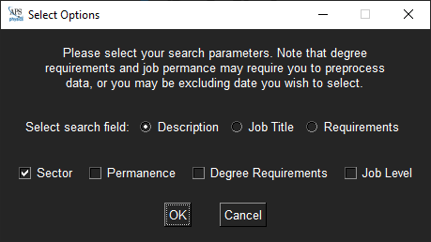
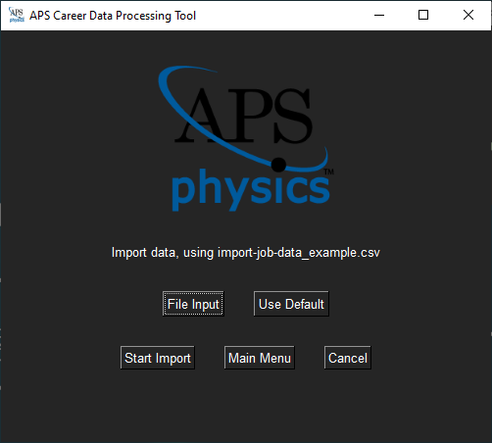
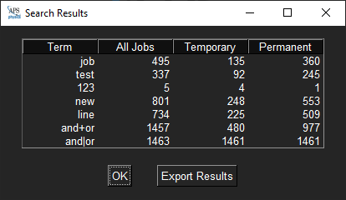
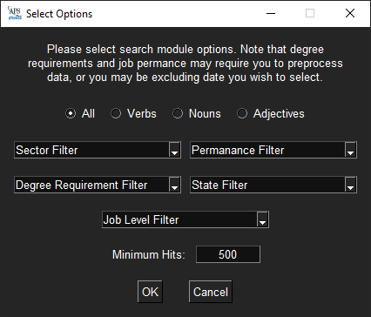
Finished Application:
Results
Find Keywords
Search Data
Import Menu

Slide 8

Results
Word cloud of keywords in all job descriptions, sized by number of occurrences

Slide 9
Results
<more visualizations of results will be displayed here and in following slides>

Slide 10
Conclusions
<conclusion bullet points will be inserted here>

Slide 11
THANKS!
Questions?
Many thanks to my project supervisor, Midhat Farooq, for her mentorship and support throughout this summer. Additionally, thanks to the amazing folks at SPS National and AIP for their work making our summer awesome!

